Slide 1


Slide 2

Business Problem
Our company operates a diverse fleet of aircraft, ranging from small business jets to medium-sized planes. We have been committed to delivering high-quality air transportation services, prioritizing the safety, comfort, and convenience of our passengers. However, we are currently encountering several challenges that are putting pressure on our profitability. To address these issues, we intend to analyze our database to discover strategies to enhance our occupancy rates, thereby increasing the average profit earned per seat.
Challenges
Stricter Environmental Regulations: New environmental regulations have been implemented to reduce the carbon footprint and environmental impact of the aviation industry. Compliance with these regulations often requires significant investments in newer, more efficient technologies or retrofitting existing aircraft, leading to increased operational costs.
Higher Flight Taxes: Governments are imposing higher taxes on flights to generate revenue and potentially discourage excessive air travel due to environmental concerns. These increased taxes directly reduce our profit margins, making it more challenging to maintain competitive pricing while ensuring profitability.
Tight Labor Market: The labor market is currently very competitive, making it difficult to attract and retain skilled workers without offering higher wages and better benefits. This results in increased labor costs, further straining our financial resources and affecting overall profitability.
This project aims to provide actionable insights that will help the company navigate the current challenges and improve its overall financial performance through data-driven decision-making. By enhancing occupancy rates, we seek to boost the average profit earned per seat, ultimately alleviating the financial pressures faced by the company.

Slide 3
Objectives
Boost Occupancy Rates: Aim to enhance the occupancy rates on underperforming flights to elevate the average profit per seat and counteract the challenges we’re facing.
Upgrade Pricing Strategy: Develop a dynamic pricing approach that adapts to evolving market conditions and customer preferences to attract and retain more passengers.
Elevate Customer Experience: Focus on delivering a seamless and convenient journey for customers, from booking to arrival, to stand out in a competitive market and foster greater customer loyalty.
The ultimate goal is to identify and leverage opportunities to improve occupancy rates on flights with lower performance, which will contribute to increased overall profitability for the airline.

Slide 4
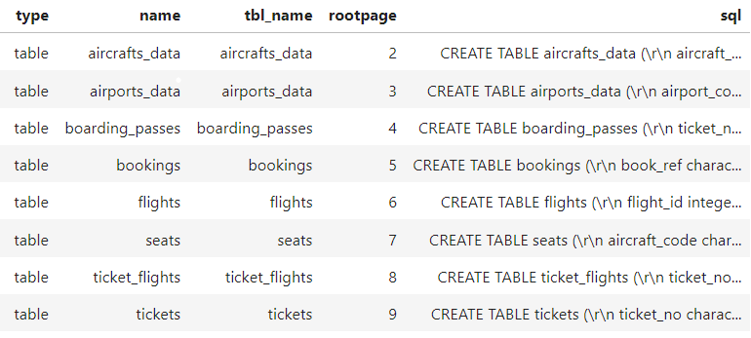
The aircrafts_data and airports_data tables provide essential information about the aircraft fleet and airport locations, which are crucial for understanding flight logistics and capacity. The flights, bookings, and tickets tables offer insights into flight schedules, passenger bookings, and ticket details, enabling the analysis of occupancy rates and revenue generation. Meanwhile, the seats, boarding_passes, and ticket_flights tables help track seat allocation and boarding processes, ensuring efficient seat utilization and customer experience management.
Fundamental Analysis
The primary objective of this project is to leverage SQL to uncover opportunities for increasing the occupancy rate on flights that are currently underperforming. By focusing on these low-performing flights, we aim to identify and implement strategies that can significantly enhance their occupancy rates.
Tables for Flight Analysis
The aircrafts_data and airports_data tables provide essential information about the aircraft fleet and airport locations, which are crucial for understanding flight logistics and capacity. The flights, bookings, and tickets tables offer insights into flight schedules, passenger bookings, and ticket details, enabling the analysis of occupancy rates and revenue generation. Meanwhile, the seats, boarding_passes, and ticket_flights tables help track seat allocation and boarding processes, ensuring efficient seat utilization and customer experience management.

Slide 5
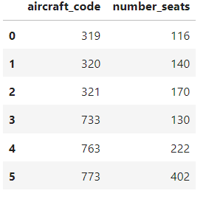
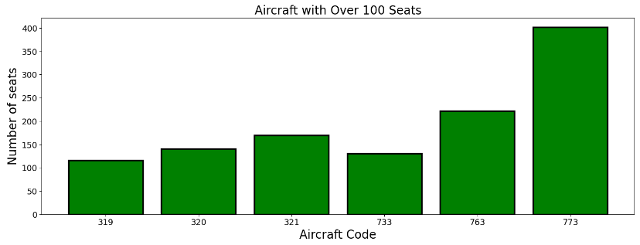
The detailed analysis of data provides insights into the number of planes with more than 100 seats, how the number of tickets booked and the total amount earned changed over time, and the average fare for each aircraft with different fare conditions. These findings will be useful in developing strategies to increase occupancy rates and optimize pricing for each aircraft. Table 1 shows the aircraft with more than 100 seats and the actual seats count.

Slide 6
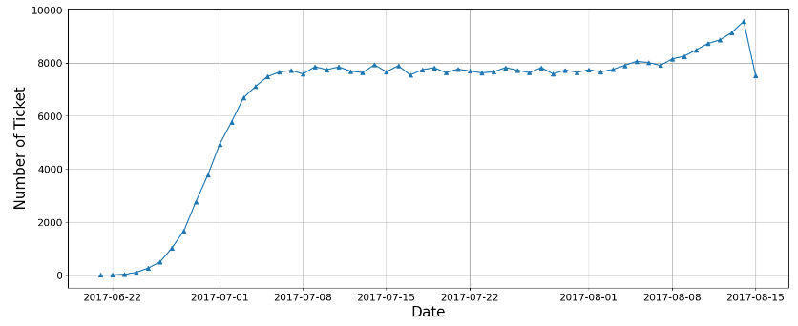
To gain a more comprehensive insight into the trend of ticket bookings and the revenue generated from those bookings, we employed a line chart visualization. Analyzing the chart reveals that the number of tickets booked shows a gradual upward trend from June 22nd to July 7th, followed by a relatively stable pattern from July 8th through August, with a significant peak in ticket bookings where the highest number of tickets was booked on a single day. It is crucial to note that the revenue generated by the company from these bookings closely mirrors the number of tickets booked. Consequently, we observe a similar pattern in the total revenue earned by the company over the analyzed period.
findings suggest that further exploration of the factors contributing to the peak in ticket bookings may be beneficial for increasing overall revenue and optimizing operational strategies.
Figure 1

Slide 7
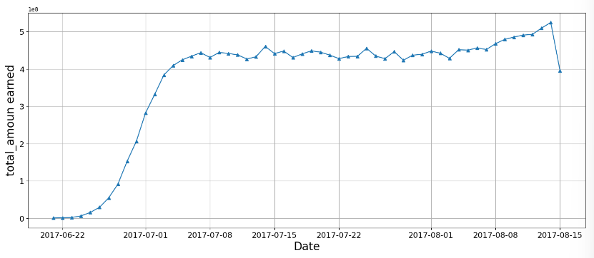
Figure 2
The bar chart highlights the average amount spent across various aircraft codes, segmented by fare conditions—Business, Economy, and Comfort. Business class consistently shows the highest average expenditure, notably exceeding 100,000 units for aircraft code 319. In contrast, Economy class expenditures are significantly lower across all aircraft codes. Comfort class data, available only for aircraft code 773, indicates moderate spending between Business and Economy classes. This visualization emphasizes the high revenue potential of Business class, suggesting targeted strategies to enhance premium service offerings. These insights can inform pricing models and marketing efforts, aiming to improve occupancy rates and maximize average profit per seat, thereby boosting the airline's financial performance.

Slide 8
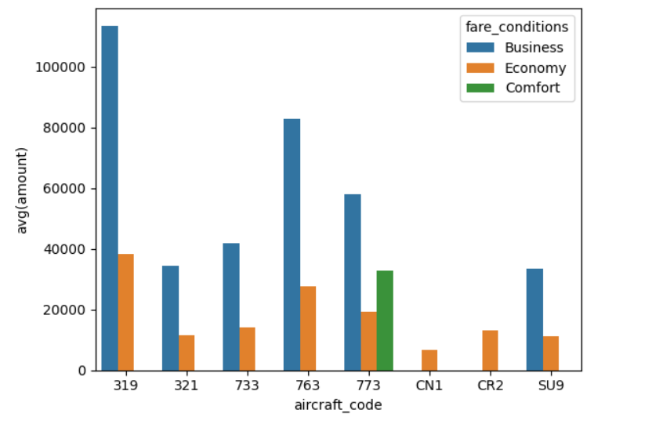
Analyzing occupancy rate
Analyzing occupancy rate Airlines must thoroughly analyze their revenue streams in order to maximize profitability. The overall income per year and average revenue per ticket for each aircraft are important metrics to consider. Aircraft code SU9 stands out as the top performer, generating an impressive total revenue of approximately $5.11 billion from 365,698 tickets, with an average revenue of around $13.99k per ticket. Close behind is aircraft code 319, which, despite handling fewer tickets (52,853), achieves a remarkable total revenue of roughly $2.71 billion and boasts the highest average revenue per ticket at about $51.20k. Another notable player is aircraft code 763, which records a substantial total revenue of about $4.37 billion from 124,774 tickets, with an average revenue per ticket of $35.03k. On the other hand, smaller aircraft like CN1 and CR2 contribute more modest revenues, with totals around $96.37 million and $1.98 billion, respectively, and average revenues per ticket of $6.57k and $13.21k. Aircraft codes 321, 733, and 773 show moderate revenue performance, ranging from approximately $1.43 billion to $3.43 billion in total revenue and average ticket revenues between $15.29k and $23.77k.

Slide 9
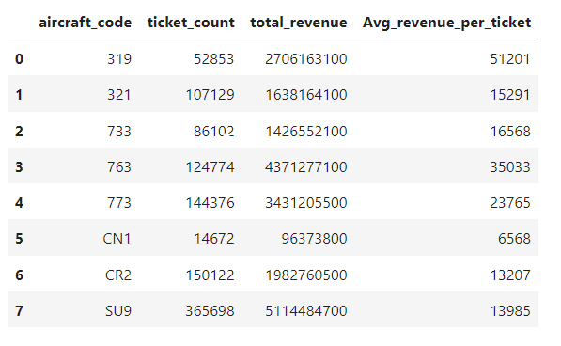
This revenue analysis highlights the substantial financial contributions of larger aircraft, particularly those with higher ticket volumes and elevated average ticket prices. Understanding these revenue patterns can inform strategic decisions aimed at optimizing fleet utilization, enhancing profitability, and targeting specific aircraft types for revenue maximization.
In evaluating the performance of various aircraft types, the analysis of occupancy rates reveals significant variations. Aircraft code 773 exhibits the highest occupancy rate at approximately 65.90%, indicating a strong utilization of its seating capacity. Following closely, aircraft code 733 has an occupancy rate of about 61.74%, reflecting a high efficiency in seat usage. Aircraft code 763 shows a solid occupancy rate of 51.32%, while aircraft code 319, with an occupancy rate of 46.19%, demonstrates lower utilization compared to the top performers.
Conversely, smaller aircraft such as CN1 and CR2 have occupancy rates of 50.04% and 42.97%, respectively. Although these rates are lower, they still suggest a moderate level of seat usage relative to their capacity. Aircraft code SU9, with an occupancy rate of 58.57%, falls in between the higher and lower performing aircraft.
Integrating this occupancy data with revenue performance, aircraft code 773 stands out not only for its high occupancy rate but also for generating approximately $3.43 billion in total revenue, underscoring its significant financial contribution. Aircraft code 763, with its occupancy rate of 51.32%, also generates a substantial revenue of around $4.37 billion. Aircraft code SU9, despite a lower occupancy rate compared to the highest performers, contributes approximately $5.11 billion in total revenue, indicating that while it may have a lower occupancy rate, its overall revenue generation remains exceptional.

Slide 10
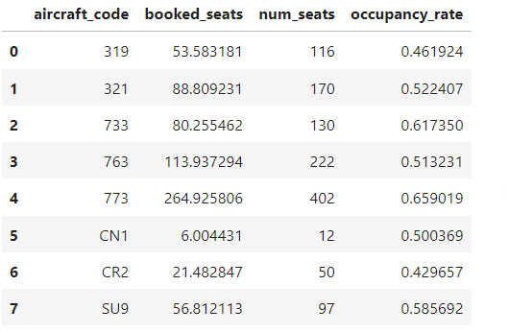
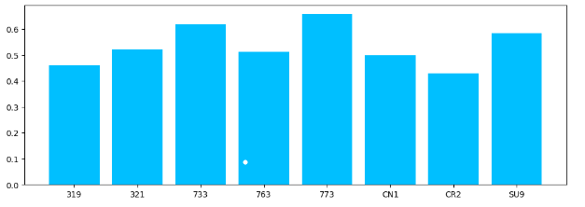
In contrast, aircraft with lower occupancy rates, such as aircraft code 319 and 321, still contribute considerable revenues—around $2.71 billion and $1.43 billion, respectively—suggesting that high average revenue per ticket can offset lower occupancy.
This analysis highlights the importance of balancing occupancy rates with revenue generation. Aircraft with high occupancy rates and high revenue per ticket, like aircraft code 773, tend to be the most profitable. However, even aircraft with lower occupancy rates can achieve substantial revenues if they maintain high average revenue per ticket. These insights are crucial for optimizing fleet operations and enhancing overall profitability.

Slide 11
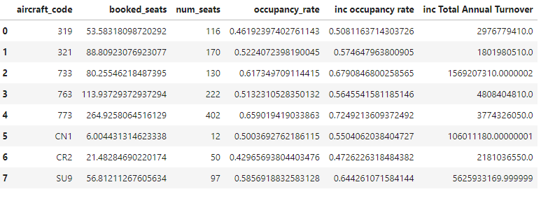
Increasing the occupancy rate of each aircraft by 10% could significantly boost total annual revenue. For instance, aircraft code SU9, currently generating approximately $5.11 billion, would see an increase of about $5.63 billion if its occupancy rate were improved. Similarly, aircraft code 763, with a current revenue of $4.37 billion, could experience an additional revenue of around $4.81 billion with the increased occupancy. Aircraft code 773, generating $3.43 billion, could see its revenue rise to about $3.77 billion.
Aircraft code 319’s revenue could increase by approximately $2.98 billion, reaching around $2.71 billion from its current figure. Aircraft code 321 could experience an increase of about $1.80 billion, reaching approximately $1.43 billion. Smaller aircraft like CN1 and CR2 would also see revenue boosts, with CN1’s revenue potentially rising to around $106 million and CR2’s by approximately $2.18 billion.
Overall, a 10% increase in occupancy rates across all aircraft could result in a substantial uplift in total revenue, highlighting the significant impact of improved seat utilization on financial performance.

Slide 12
Conclusion
In the airline industry, analyzing key revenue indicators like total revenue per year, average revenue per ticket, and average occupancy per aircraft is essential for enhancing profitability. By evaluating these metrics, airlines can pinpoint areas for improvement and refine their pricing and route strategies. A critical factor in boosting profitability is increasing occupancy rates, which enables airlines to optimize revenue and reduce the costs associated with empty seats. To address pricing challenges, airlines should adjust fares to reflect the condition and amenities of each aircraft, ensuring that prices are neither too high nor too low to attract passengers effectively.
However, improving occupancy rates should not compromise customer satisfaction or safety. Maintaining a balance between profitability and high-quality service is crucial. Airlines may achieve long-term success in a highly competitive business by adopting a data-driven revenue analysis and optimization strategy.

